Slide 1
Computer Vision and Deep Learning
Lecture 11

Slide 2
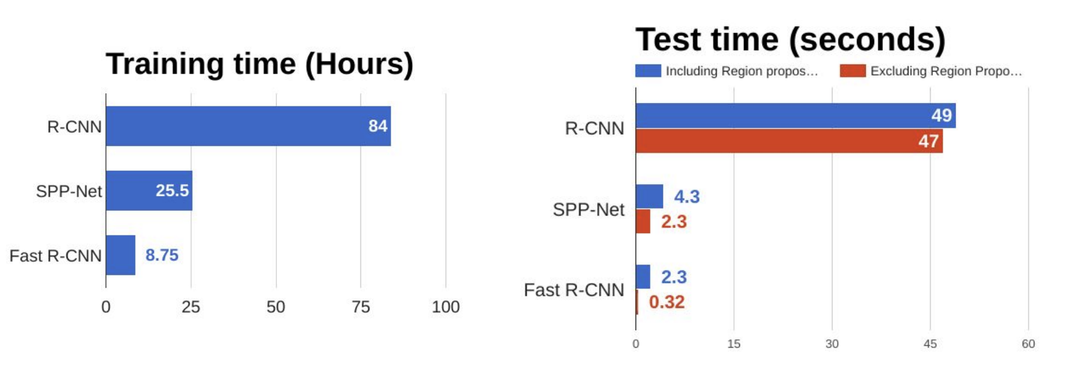
Fast RCNN
What is the most time consuming part of Fast RCNN?

Slide 3
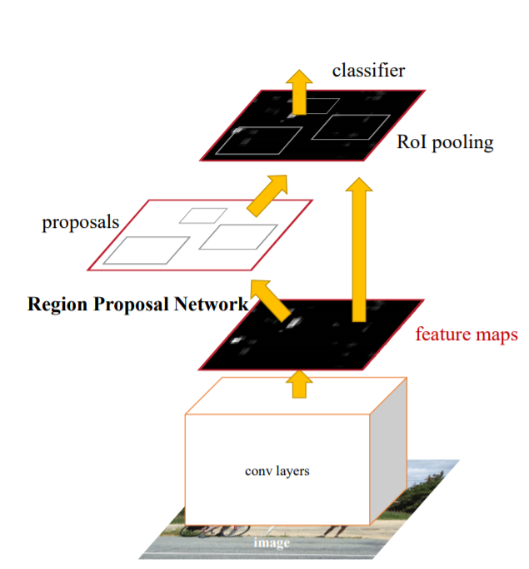
Faster-RCNN
Unified framework for object detection
The rest of the network is similar to Fast RCNN: use ROI pooling to crop feature maps and classify each region
Region proposal network:
replaces selective search and predicts regions directly from feature maps

Slide 4
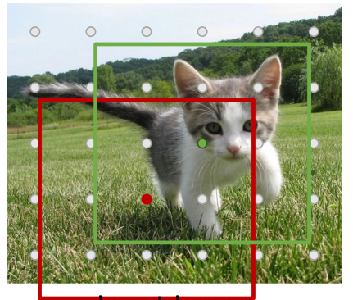
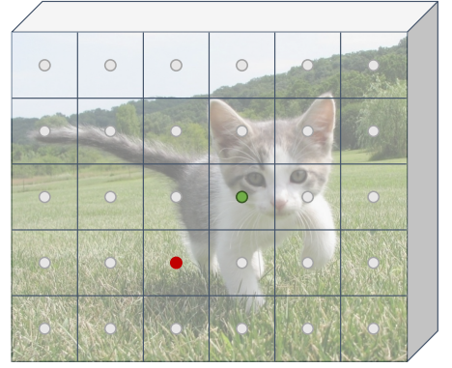
Region proposal newtork
Run image through backbone CNN (features are aligned to input image) -> Each feature corresponds to a point in the input
Anchor box of fixed size at each position of the feature map
3x480x640
512x5x6

Slide 5
Region proposal newtork
Run image through backbone CNN (features are aligned to input image) -> Each feature corresponds to a point in the input
Anchor box of fixed size at each position of the feature map
- for each anchor:
- is it an object or not?
- bbox transformation
2x5x6
4x5x6
3x480x640
512x5x6

Slide 6
Region proposal newtork
Run image through backbone CNN (features are aligned to input image) -> Each feature corresponds to a point in the input
Anchor box of fixed size at each position of the feature map
- for each anchor:
- is it an object or not?
- bbox transformation
K anchor boxes
2Kx5x6
4Kx5x6
3x480x640
512x5x6

Slide 7
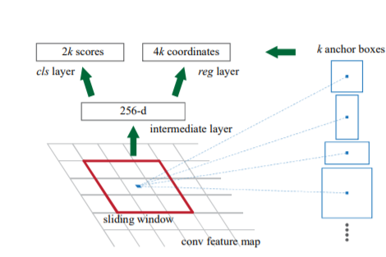
Region proposal network
takes an image (of any size) as input and outputs a set of rectangular object proposals, each with an objectness score
An anchor box of fixed size at each point in the feature map
For each anchor box predict if there is an object inside it
For “positives” predict corrections for the bounding boxes

Slide 8
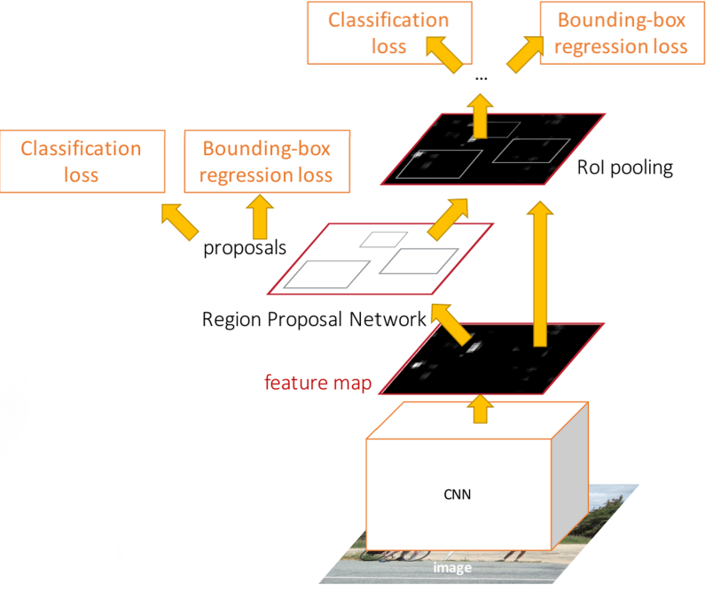
Faster RCNN
Multi-loss training
Region proposal network: objectness classification
Region proposal network: bbox coordinates
Final classification score
Final bbox coordinates

Slide 9
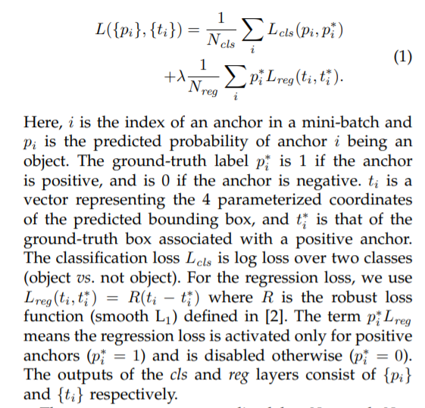
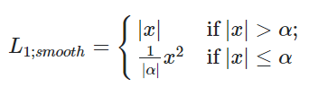
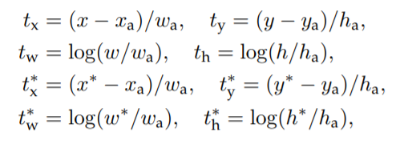
Faster RCNN Loss
t* - ground truth
t –prediction
h_{a} , w_{a} – anchor box
bounding-box regression from an anchor box to a nearby ground-truth box.

Slide 10
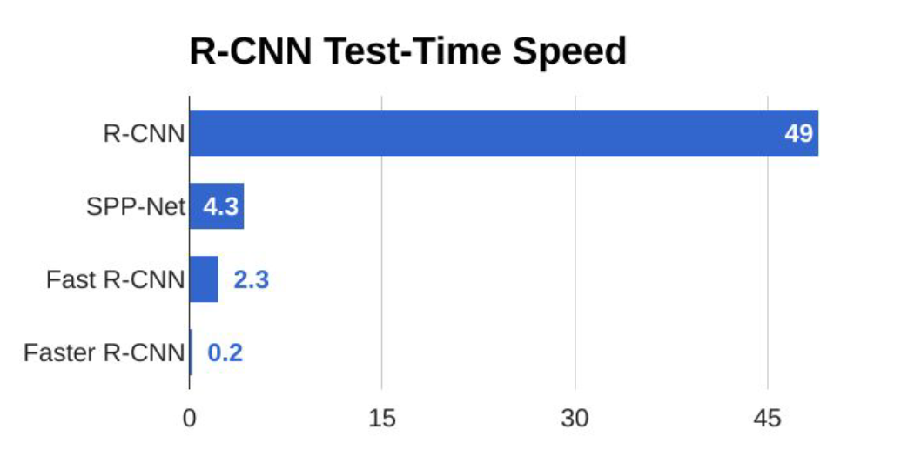

Slide 11
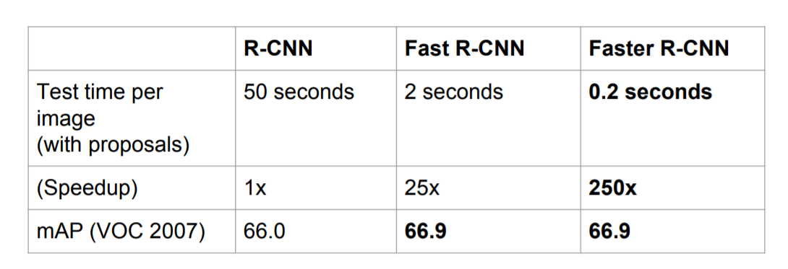

Slide 12
One stage object detection

Slide 13
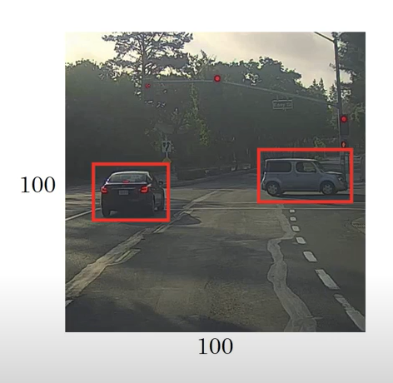

Slide 14
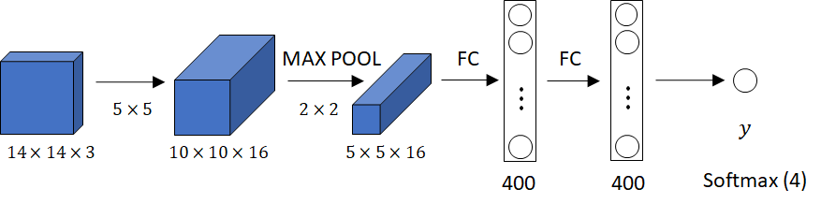
Convolutional implementation of sliding windows
https://www.youtube.com/watch?v=XdsmlBGOK-k
Example credit Andrew Ng

Slide 15
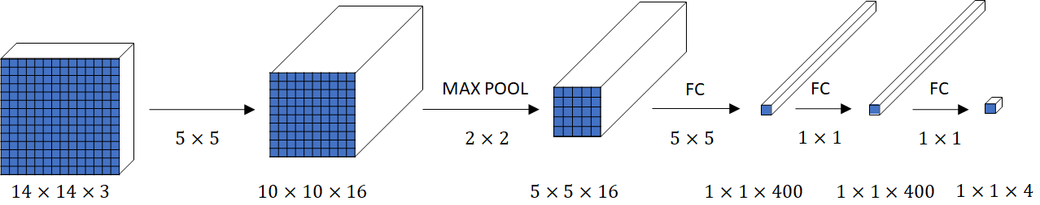
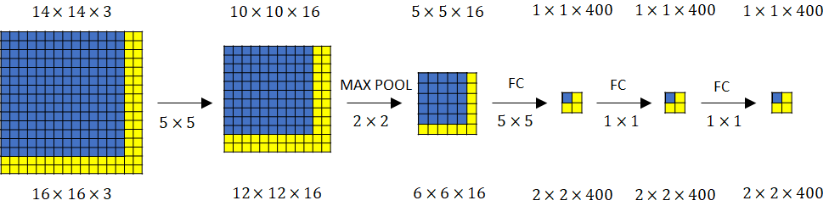
Convolutional implementation of sliding windows
https://www.youtube.com/watch?v=XdsmlBGOK-k
Example credit Andrew Ng

Slide 16
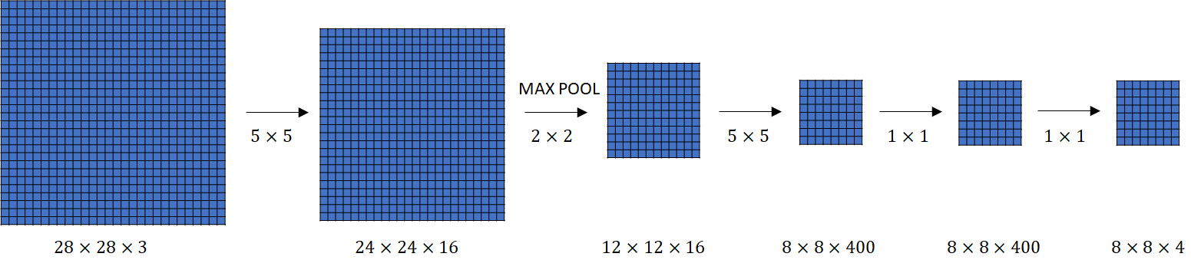
Convolutional implementation of sliding windows
https://www.youtube.com/watch?v=XdsmlBGOK-k
Example credit Andrew Ng

Slide 17
YOLO You only look once
Detection is modelled as a regression problem
image is divided into an S × S grid
for each grid cell predict:
B bounding boxes (4 values per bbox)
confidence for those boxes,
C class probas

Slide 18
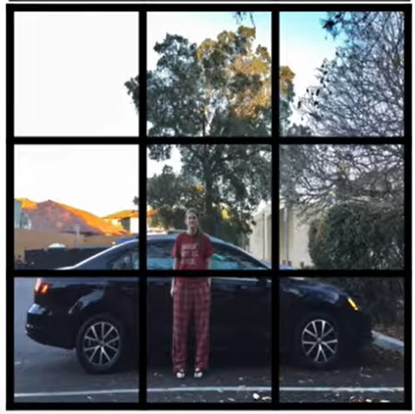
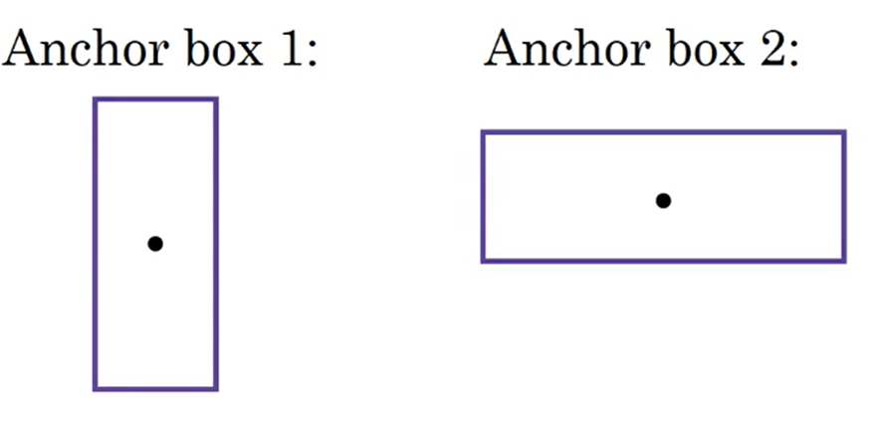
YOLO Anchor boxes
Allows the object detector to specialize better (detect “thinner” or “wider” objects)
https://www.youtube.com/watch?v=RTlwl2bv0Tg

Slide 19

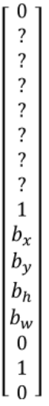
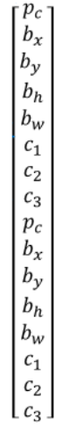
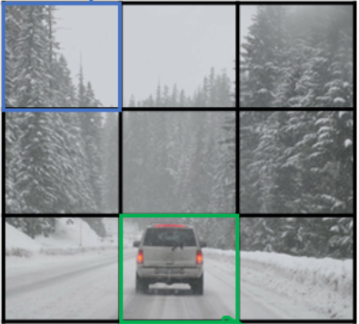
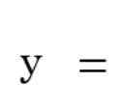
YOLO Example with two anchor boxes and 3 classes, S = 3

Slide 20
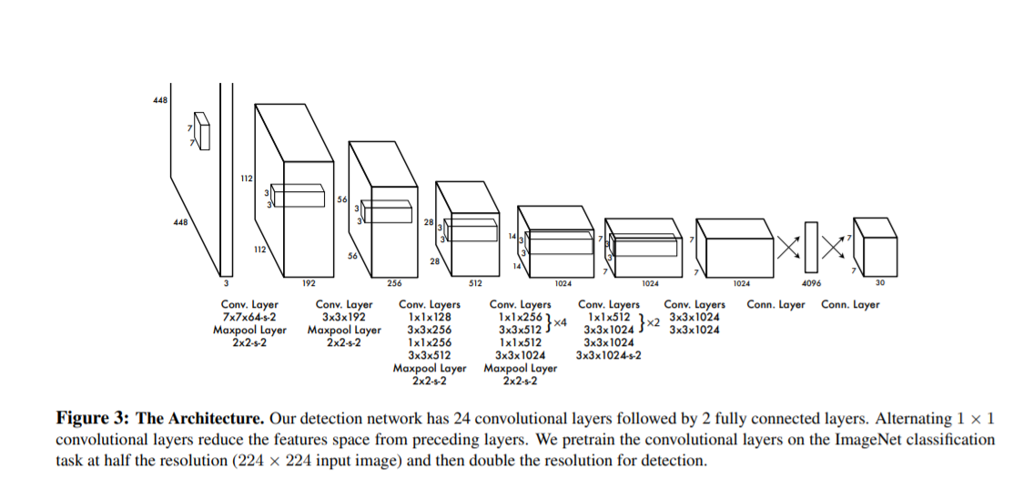
For evaluating YOLO on PASCAL VOC, we use S = 7, B = 2. PASCAL VOC has 20 labelled classes so C = 20. Our final prediction is a 7 × 7 × 30 tensor

Slide 21
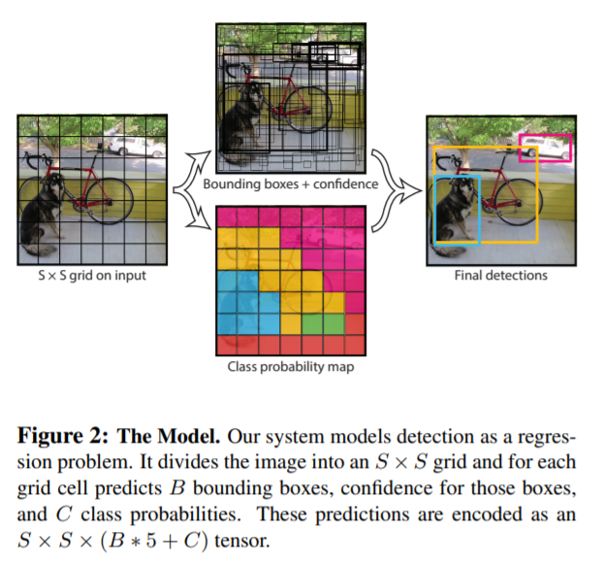

Slide 22
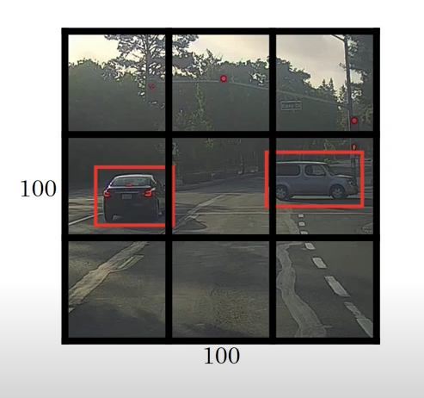

Slide 23
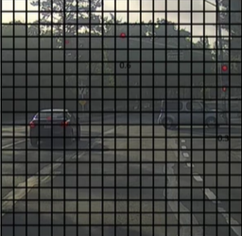
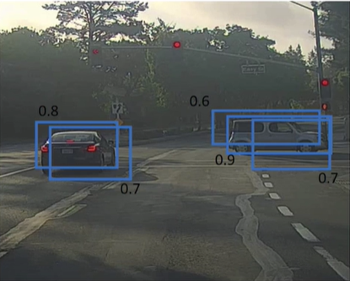
YOLO Non maximum suppression
Discard all predictions with proba <= threshold
while there are any remaining boxes
Select the box with the largest proba (maxBB) as a prediction
Discard boxes with IoU >= 0.5 with maxBB
https://www.youtube.com/watch?v=VAo84c1hQX8

Slide 24
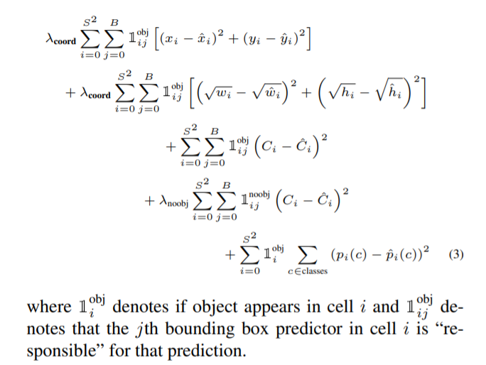
YOLO Loss function
This is the loss function for yolo v1 paper.
Here each bounding box predicts an objectness score and a 4 coordinates, but the class predictions are per cell. Hence this:

Slide 25
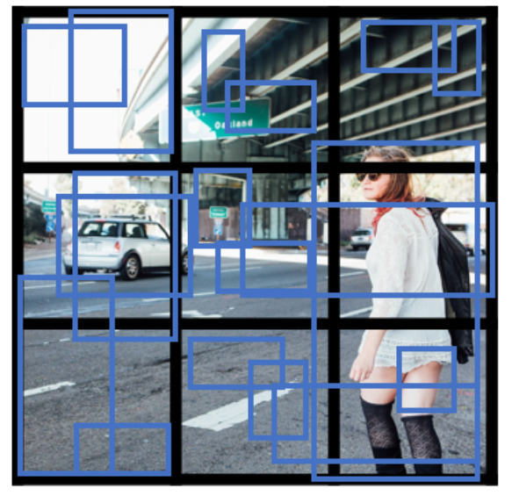
YOLO – making predictions
1.Run CNN on input images (example: S = 3, B = 2)
Num bboxes: SxSxB

Slide 26
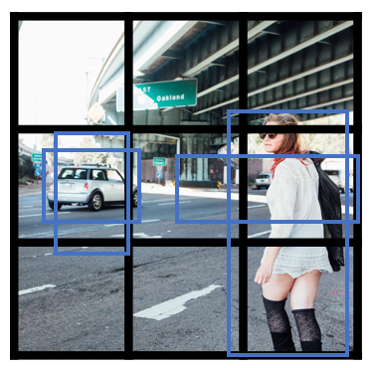
YOLO – making predictions
1.Run CNN on input images (example: S = 3, B = 2)
2. Remove low predictions

Slide 27

YOLO – making predictions
1.Run CNN on input images (example: S = 3, B = 2)
2. Remove low predictions
3. NMS

Slide 28
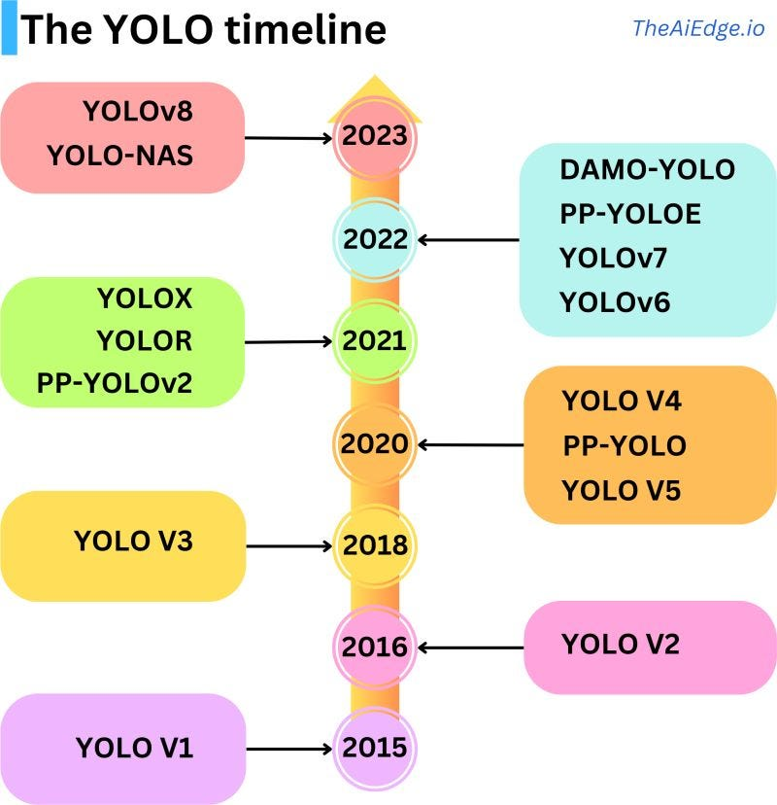

Slide 29
Instance segmentation

Slide 30
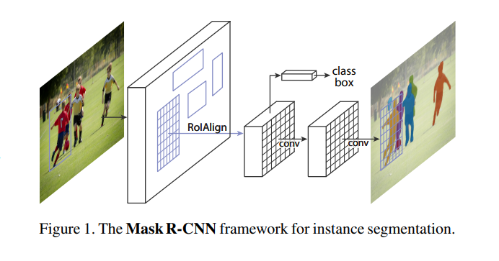
Mask R-CNN
Just like Faster-RCNN
Also predict a 14x14 mask for each of the C classes (semantic segmentation mini-net)

Slide 31
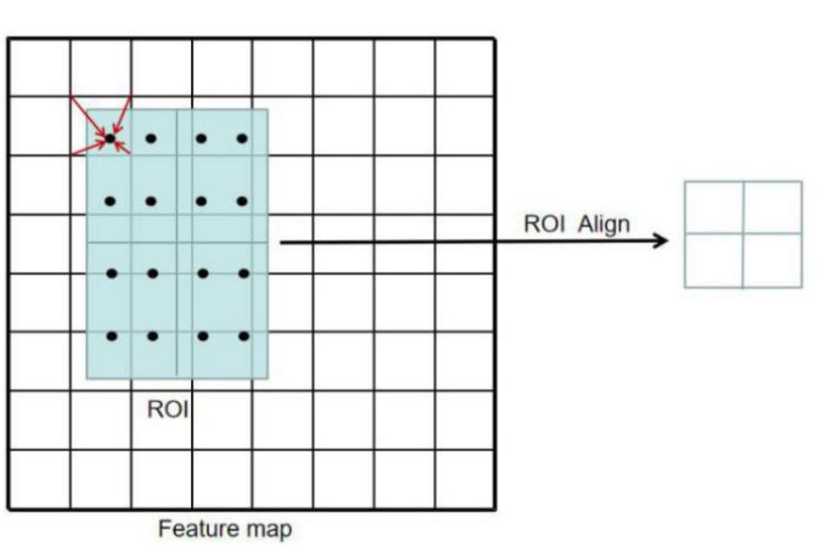
ROI align
Cropping features using RoI Pooling: “snap” to grid cells
Cropping features using RoI Align: No “snapping”
Divide into equal-sized subregions (may not be aligned to grid!)
Sample features at regularly-spaced points in each subregion using bilinear interpolation

Slide 32
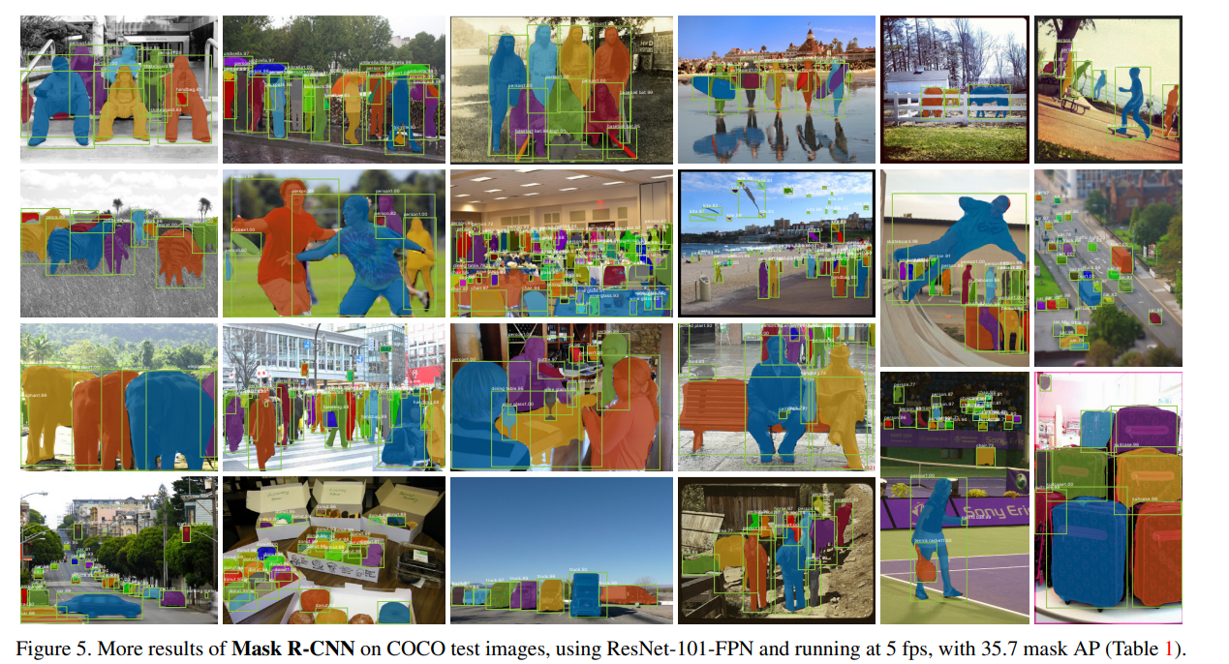

Slide 33
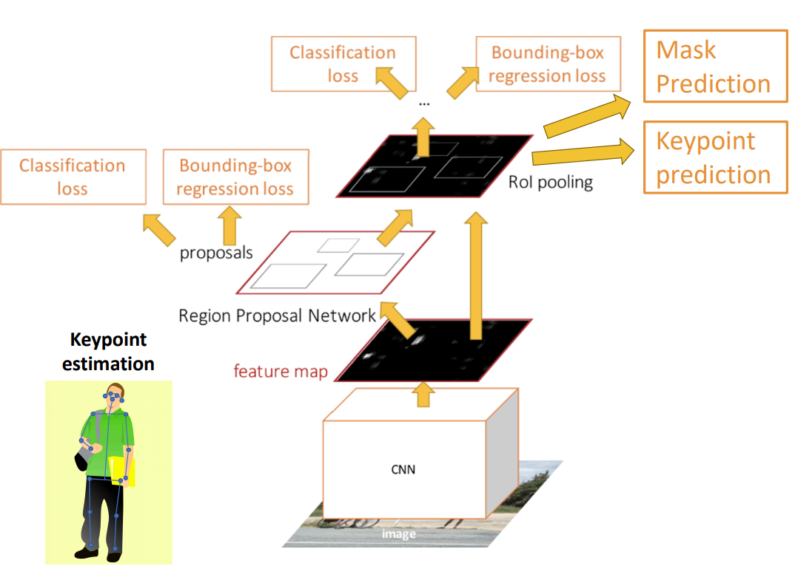
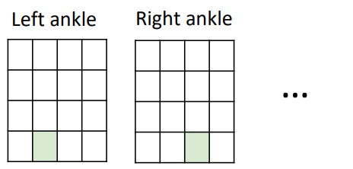
Mask RCNN Beyond instance segmentation
One mask for each of the K different keypoints
Each ground truth mask has a single pixel turned on

Slide 34
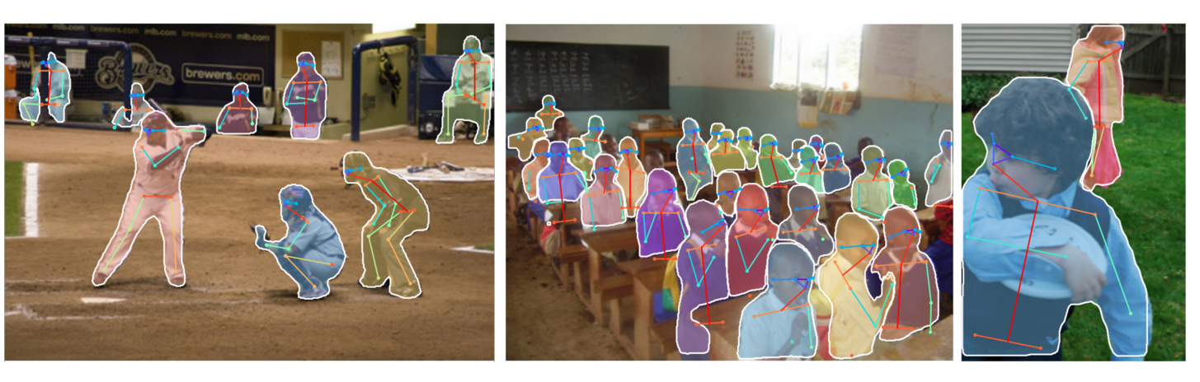
Mask RCNN Beyond instance segmentation

Slide 35
Panoptic segmentation

Slide 36
Panoptic segmentation
Things: Object categories that can be separated into object instances (e.g. cats, cars, persons)
Stuff: Object categories that cannot be separated into instances (e.g. sky, grass, water, trees)
Label all pixels in the image (both things and stuff)
For “thing” categories also separate into instances

Slide 37
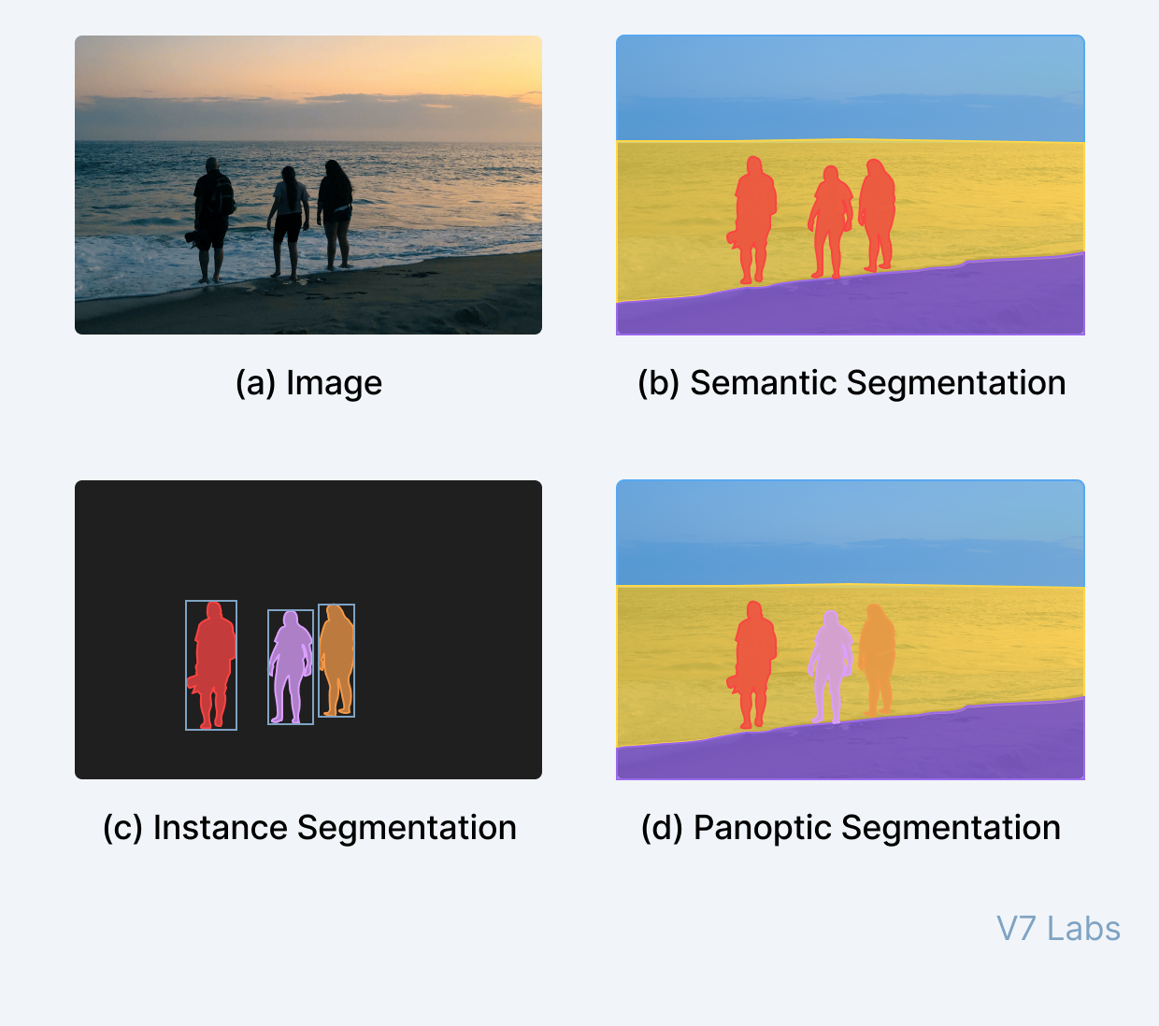
Panoptic segmentation

Slide 38
DETR: End-to-End Object Detection with Transformers
https://github.com/facebookresearch/detr

Slide 39
DETR
Simplifies the process of object detection by formulating object detection as a direct set prediction problem
Previous methods make predictions based on some initial guesses
Two stage methods predict objects w.r.t. proposals
Single stage methods predict objects w.r.t. a grid of possible object centers
DETR reasons about the relations of the objects and the global image context to directly output the final set of predictions in parallel

Slide 40
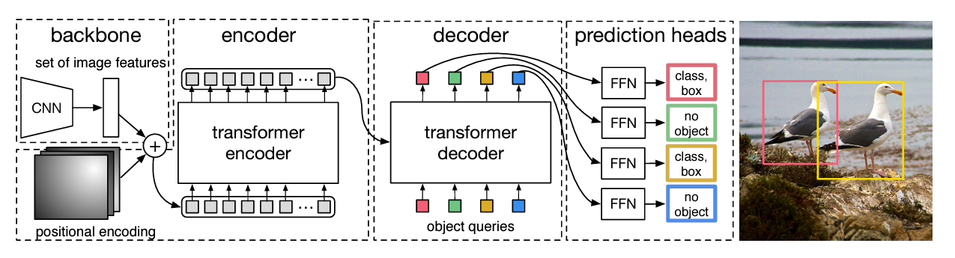
DETR
DETR infers a fixed-size set of N predictions, in a single pass through the model, where N is significantly larger than the typical number of objects in an image

Slide 41
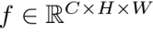
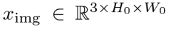
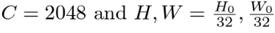
DETR
Starting from the initial image, a CNN backbone is used to extract a compact feature representation with a lower resolution feature map
CNN

Slide 42
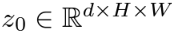
DETR
- 1x1 convolution to reduce the channel dimension from C to d
- collapse spatial dimensions (the encoder expects a sequence) and obtain d x HW feature map
- standard encoder architecture: MHA, FFN
- add positional encodings as the encoder is permutation invariant

Slide 43
DETR
- as opposed to the standard architecture of the Transforme decoder, which operates in an auto-regressive manner, in DETR this module decodes the N objects in parallel
- object queries: learned N input embeddings (they are added to the input of each attention layer)
- the N object queries are transformed into an outpute mbedding by the decoder

Slide 44
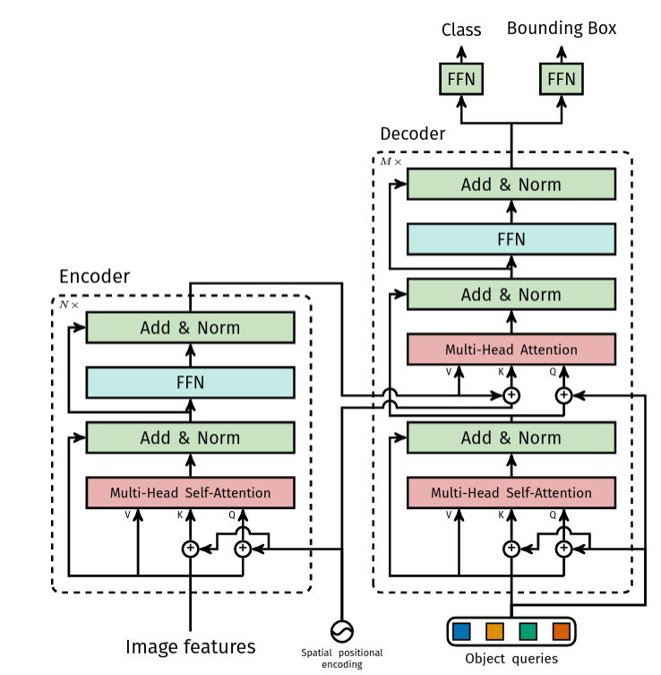
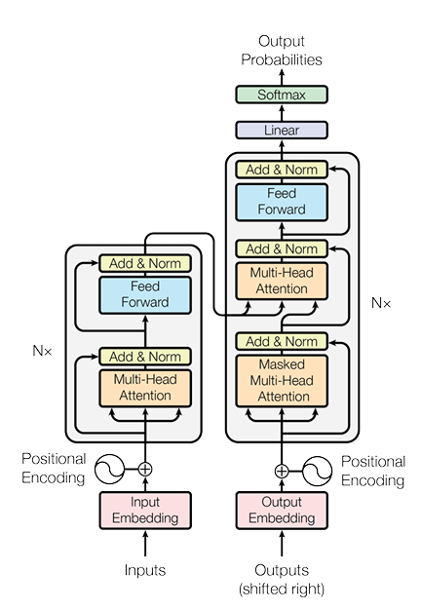
DETR
Using self- and encoder-decoder attention over these embeddings, the model globally reasons about all objects together using pair-wise relations between them, while being able to use the whole image as context
Original transformer architecture

Slide 45
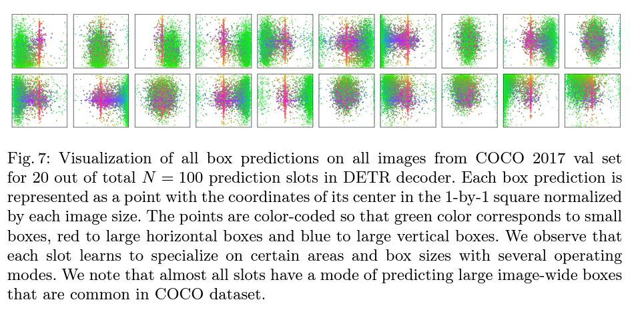
DETR Object queries

Slide 46
DETR
- 3 layer perceptron with ReLU and hidden dimension d and a linear projection layer
- predicts normalized center coordinates, height and width w.r.t. to the input image and the class label
- since N is usually much larger than the actual number of objects of interest in an image a special class label ∅ (no object/”background”)

Slide 47
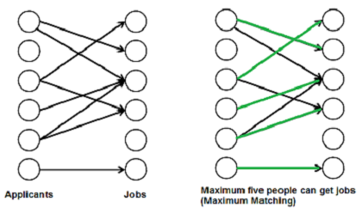
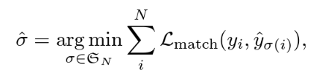


DETR
Object detection prediction loss
Let
$\hat{y}$- the set of N predictions
y – ground truth objects, padded with ∅ such that it also has size N
Search for a permutation of N elements with the lowest cost
Pair-wise matching cost between ground truth $y_{i}$ and a preidiction with index $σ(i)$

Slide 48

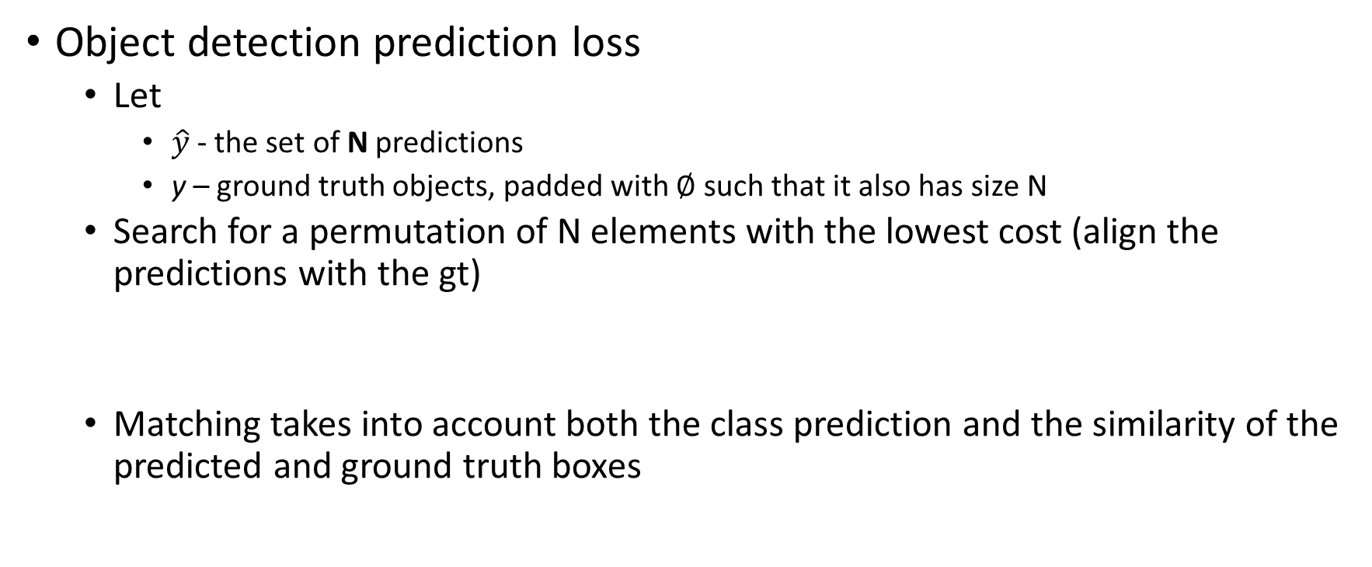
DETR
Object detection prediction loss
Let
$\hat{y}$- the set of N predictions
y – ground truth objects, padded with ∅ such that it also has size N
Search for a permutation of N elements with the lowest cost (align the predictions with the gt)
Matching takes into account both the class prediction and the similarity of the predicted and ground truth boxes

Slide 49


DETR
Second step is to compute the loss function for all the pairs previously matched:
Bounding box loss: the box are predicted directly and not w.r.t. initial guesses

Slide 50

DETR

Slide 51
Adversarial examples

Slide 52



Slide 53

“Adversarial” examples for the human brain #thedress
#whiteandgold
#blackandblue

Slide 54


Slide 55

Adversarial examples
An adversarial example is an instance with small, intentional feature perturbations that cause a machine learning model (!not only CNNs!) to make a false prediction.

Slide 56

Make everything an ostrich
Szegedy, Christian, et al. "Intriguing properties of neural networks." arXiv preprint arXiv:1312.6199 (2013).

Slide 57

Classifying noise
Nguyen, Anh, Jason Yosinski, and Jeff Clune. "Deep neural networks are easily fooled: High confidence predictions for unrecognizable images." Proceedings of the IEEE conference on computer vision and pattern recognition. 2015.

Slide 58


1-pixel attacks
Constraint: when designing the adversarial example only one pixel may change
One Pixel Attack for Fooling Deep Neural Networks, Su et al. , 2019

Slide 59

Adversarial patch Make everything a toaster

Slide 60


Slight alterations in the physical world
https://spectrum.ieee.org/cars-that-think/transportation/sensors/slight-street-sign-modifications-can-fool-machine-learning-algorithms

Slide 61

Adversarial examples occur not only for CNNs but also for handcrafted features
HOG descriptor
Exploring the Representation Capabilities of the HOG Descriptor, Tatu et. al

Slide 62

Understanding what networks learn
Much learning does not teach understanding. - Heraclitus

Slide 63


Saliency maps via image occlusions
P(cat) = 0.4
P(cat) = 0.96

Slide 64

Saliency maps via image occlusions
Which are the important parts of an image?
Slide an occluding patch over the input image and display (as a heat map) the probability of the correct class

Slide 65
Filter visualization – 1st layer
First layer operates directly on image pixels; visualize the filters used to extract the image features
Visualize this filter bank
https://machinelearningmastery.com/how-to-visualize-filters-and-feature-maps-in-convolutional-neural-networks/

Slide 66

Filter visualization – 1st layer
First layer operates directly on image pixels; visualize the filters used to extract the image features

Slide 67


Filter visualization – deeper layers
Not that easy to interpret
https://cs.stanford.edu/people/karpathy/convnetjs/demo/mnist.html

Slide 68
Last layer visualization
The last layer (before the classification layer) contains the most condensed representation of the image

Slide 69

Last layer visualization Image embedding
Five ILSVRC-2010 test images in the first column. The remaining columns show the six training images that produce feature vectors in the last hidden layer with the smallest Euclidean distance from the feature vector for the test image

Slide 70

Visualize the patch that maximally activates a neuron
Single out a particular unit (feature) in the network and use it as if it were an object detector in its own right
compute the unit’s activations on a large set of held-out region, sort the proposals from highest to lowest activation, perform non-maximum suppression, and then display the top-scoring region
https://arxiv.org/pdf/1311.2524.pdf

Slide 71
Activation maps
Deep visualization toolbox #deepvis
https://www.youtube.com/watch?v=AgkfIQ4IGaM

Slide 72
Activation maps
Compute the gradient of a given neuron in the network with respect to the input image
Select the layer, set the gradient at that level to be all zeros except for the neuron of interest (where we set the gradient at 1)
Apply back-propagation to the image
https://arxiv.org/pdf/1412.6806.pdf

Slide 73

Activation maps
Zero out all the gradients except for the neuron of interest
https://arxiv.org/pdf/1412.6806.pdf

Slide 74
Activation maps
RELU during backward pass: block the gradients for the neurons that had activations < 0
RELU
https://arxiv.org/pdf/1412.6806.pdf

Slide 75
Activation maps
Guided back-propagation: backprop only the parts that have a positive gradient
Paths of influence
Pass only gradients that have a positive influence. Keep only the positive influence
https://arxiv.org/pdf/1412.6806.pdf

Slide 76

Activation maps
Visualization of patterns learned by the layer conv6 (top) and layer conv9 (bottom) of the network trained on ImageNet.

Slide 77
Saliency maps – visualize the data gradient Important image pixels
Heat map of the gradients
Compute gradient of the (un-normalized) class score with respect to image pixels and then take absolute value and max over RGB channels
Strength of influence of each pixel on the class score
https://arxiv.org/pdf/1312.6034.pdf

Slide 78

Saliency maps – visualize the data gradient Important image pixels
https://arxiv.org/pdf/1312.6034.pdf

Slide 79

Guided image segmentation
https://arxiv.org/pdf/1312.6034.pdf

Slide 80

Optimize the image
Keep the parameters of the network fixed and optimize the input image for some class score
Zero image
Forward pass
Set the gradient of the scores vector to be all zeros except for the class of interest and then back-prop to the image
[0, 0, …., 0, 1, …, 0]
Small image update
Forward image to the networks
repeat

Slide 81

Optimize the image
https://arxiv.org/pdf/1312.6034.pdf

Slide 82

Optimize the image
https://arxiv.org/pdf/1312.6034.pdf

Slide 83
Deep Dream
“Dream” at a given layer of the network (after the ReLu units)
Forward pass to the give image
Set the gradients to be equal to the activation
Backprop to the image
Modify the image such that it amplifies the activations at any given layer
https://github.com/google/deepdream/blob/master/dream.ipynb

Slide 84


Deep Dream
Whatever was activates gets boosted

Slide 85

Deep Dream

Slide 86

Deep Dream

Slide 87

Deep Dream

